Slide 1
Last Updated | July 09, 2021
Beginner
Crowdfunding Workshop
plan for hidden expenses and avoid common pitfalls

Slide 2

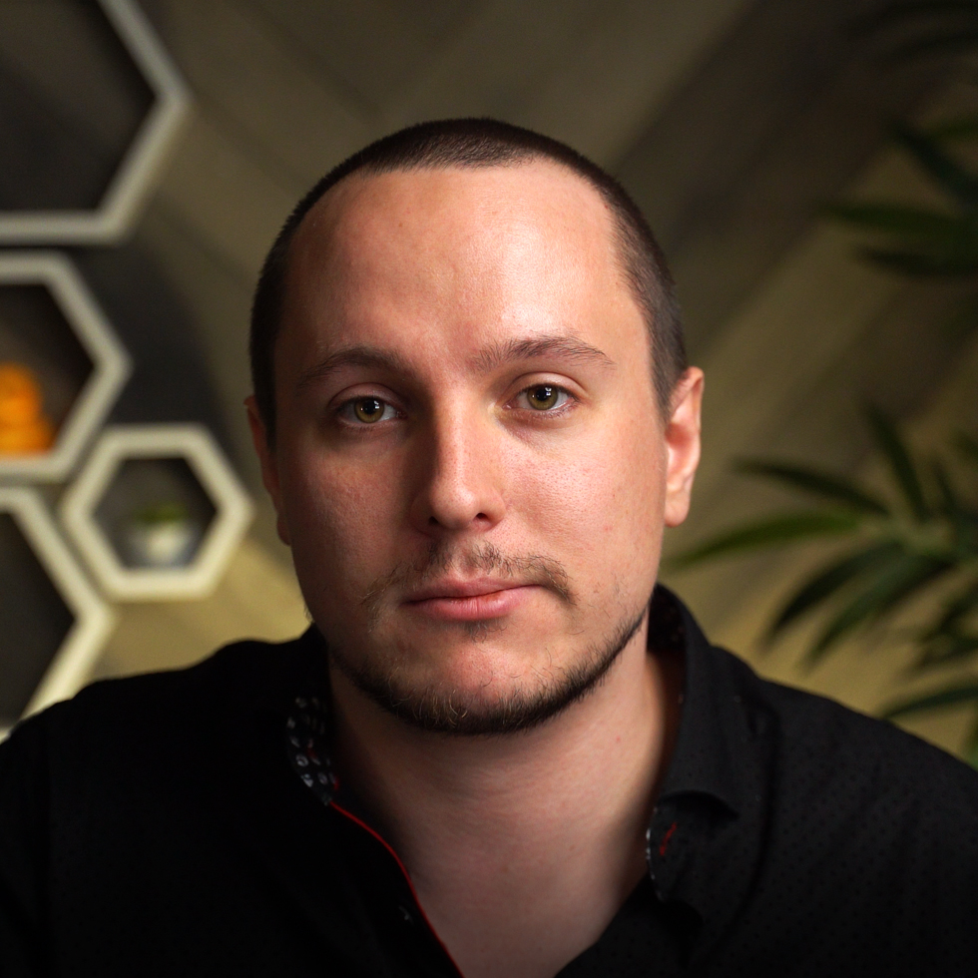








People First Marketing
Ecommerce
Web Development
Branding
Email Marketing
Film & Photography
Education
Crowdfunding
Digital Advertising
Using transparency and communication to build business relationships.
Aron Murch | Co-Owner, CIO
Worked in marketing since 2005
Joined 2H Media in January, 2020
Over $1,000,000 raised on Kickstarter
Involved in 25 Crowdfunding Campaigns
519-835-3009
hello@2h.media

Slide 3
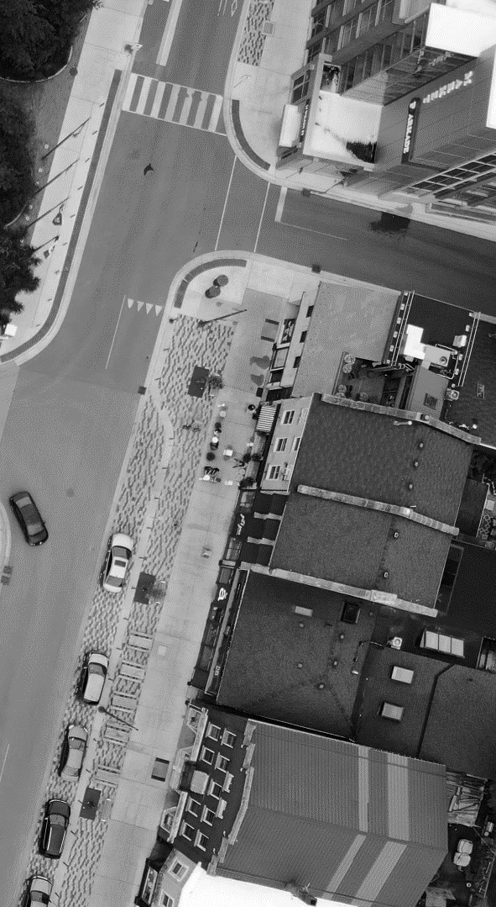
What you’ll learn
What is Crowdfunding
Choosing a Platform
Preparing for Success
Financial Breakdown
Stretch Goals
Shipping Considerations
Crowdfunding Timeline
Common Mistakes

Slide 4
What is Crowdfunding?
Pre-Orders with more steps
Crowdfunding Defined
Crowdfunding is the process of funding a project or venture by raising many small amounts of money from a large number of people, typically via the internet.
Crowdfunding is typically a method of generating pre-sales prior to manufacturing.
Reasons to Crowdfund
Generate start-up capital without reducing equity
Validate your concept in a public forum
Reach a global audience on a trusted platform

Slide 5

Choosing a Platform
Evaluate and match business needs
Has the widest audience
“All or nothing” funding
Intended for entrepreneurs
Somewhat well known
“Any collected” funding
Intended for entrepreneurs
Lowest fees on this list
Flexible funding options
Intended for causes

Slide 6
Preparing for Success
Treat a Crowdfunding Campaign Like a Sale
You should Know
63.5% of all Kickstarter campaigns fail to fund.
Preparing for a crowdfunding campaign requires a lot of preparation and up-front investment. A campaign that is not properly planned will fail before it has started.
You will need
Prototypes
Numerous images
Significant graphic design
At least 1 video
30+ days of focus

Slide 7
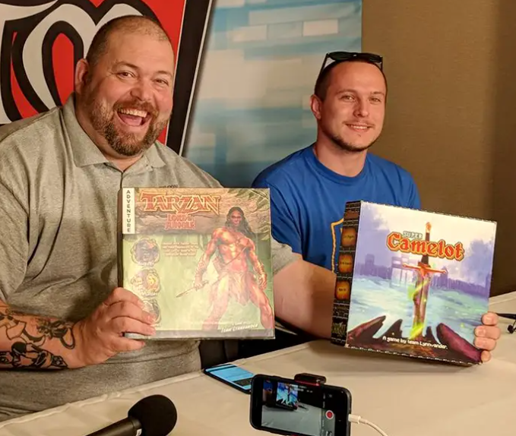
Prototyping
GEnCon Indy | August, 2018
Make it as realistic as possible.
Your prototype(s) will be used to create campaign graphics, solicit reviewers/influencers, and show backers you mean business.

Slide 8
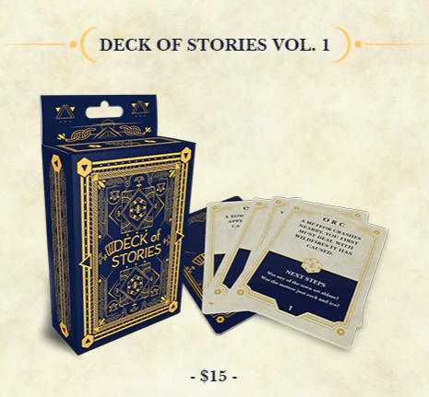
Images & Graphics
Deck of Stories & NPC Cards
Create an engaging campaign
Significant graphic design will be required to create engaging graphics that display reward tiers, stretch goals, add-ons, shipping rates, etc.

Slide 9
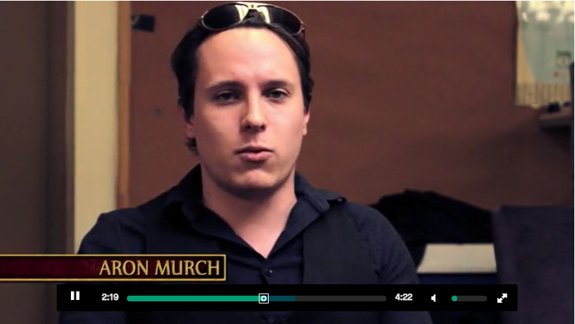
Video Introduction
Albion’s Legacy | 2014
Make a personal appeal
A well crafted video helps backers invest in both your product and you. Be prepared to make an impression on people.

Slide 10
Financial Breakdown
Understand the types of costs
Investment
Prototyping
Media
Marketing strategy
Samples
Setup
Warehousing
Digital advertising
Production*
Manufacturing
Shipping from the factory
Shipping to backers
VAT/Duty
Packing materials
Fulfillment service
Platform fees (~9%)
Operation
Media
Marketing strategy
Samples
Warehousing
Packing materials
Fulfillment service
Website
*These are the only ones you get to recoup during the campaign

Slide 11
Stretch Goals
Can we have more stuff? And can it be free?
What is a Stretch Goal?
Additional value that is automatically added to the campaign if the funding level far exceeds the goal. This could be a new feature, improved component, or even a purchasable add-on.
Effective Goal Features
Excites backers
Easy to explain
Inexpensive to ship
Improves the retail product
Fast to produce

Slide 12
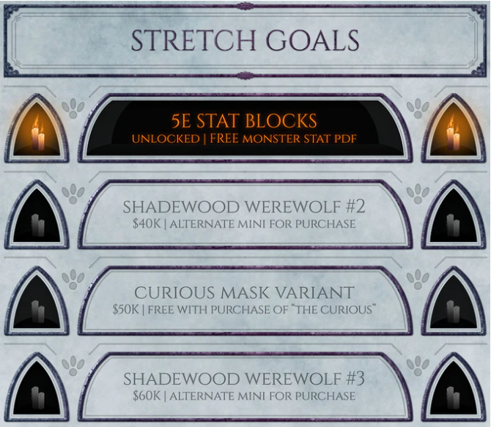
Why They Work
The Shade Collection | 2020
Excitement and Buy-IN
Stretch goals power up campaigns by making backers feel like they’re involved in something exclusive, and are getting a deal. Once stretch goals start to unlock, they feed ongoing updates and social media.

Slide 13
Shipping Considerations
Take the same approach as an online store
Fulfilling your campaign
After your campaign funds, you are responsible for fulfilling your pledge rewards. Shipping doesn’t have to be free but it does have to be clearly communicated. Plan your shipping costs in advance and research the requirements for shipping internationally (including tracking and duties).
Key Decisions
Free Shipping or charge after funding?
Which countries will be supported?
Will products be shipped

Slide 14
Crowdfunding Timeline
Take the same approach as an online store
Prepare
Plan your campaign as early as possible.
Launch
Actively manage your campaign.
3 MONTHS +
30 DAYS
30 DAYS
ONGOING
Promote
Announce the campaign and start advertising.
Fulfill
Deliver rewards and send updates.

Slide 15
Common Mistakes
How Creators fail to fund or fund and go broke
Planning
Not researching all costs
Setting the funding goal too low or too high
Not knowing the target audience
Execution
No active management
No ongoing marketing
Getting caught up in the excitement (and making promises)
Follow-Up
Failure to fulfill
Infrequent updates
No plan for warehousing and distribution
No long-term business plan

Slide 16

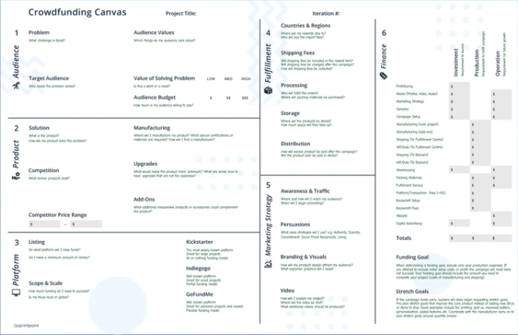
Questions?
How do I get the slides?
Visit https://2h.media. The slides are on the workshop page.
How do we connect?
Follow 2H Media on LinkedIn.
Specific questions?
Give us a call.
P: 519-835-3009
E: hello@2h.media
Plan your campaign with a Crowdfunding Canvas, available free on sprintpoint.ca.

